Slide 1
1305 7th Street West – Bennett’s Chop & Railhouse
ABZA 26-2, DSIAPP-000317-2026
Pang Yang – Department of Safety & Inspections, Zoning Section

Slide 2
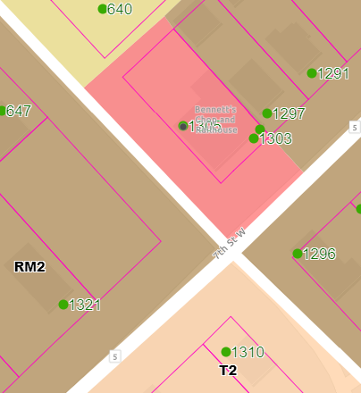
1305 7th Street West
H2
Bennett’s Chop & Railhouse
0.1363-acre parcel
Surrounding Zoning/Land Uses
Medium-Density Multiple-Family Residential (RM2)
Residential (H2)
Traditional Neighborhood (T2)
B2
B2 – Community Business

Slide 3
Section 64.405. - Signs with dynamic display
Location and orientation. Business signs with dynamic display shall be at least seventy-five (75) feet, as measured along the road, from a residential district, and shall be at least fifty (50) feet from a residential district, measured radially. Signs with dynamic display intended to be read from a freeway shall be at least six hundred sixty (660) feet as measured along the freeway from any other sign with dynamic display designed to be read by drivers heading in the same direction. Signs with dynamic display shall not interfere with traffic and road safety due to placement and orientation as determined by the city traffic engineer.

Slide 4
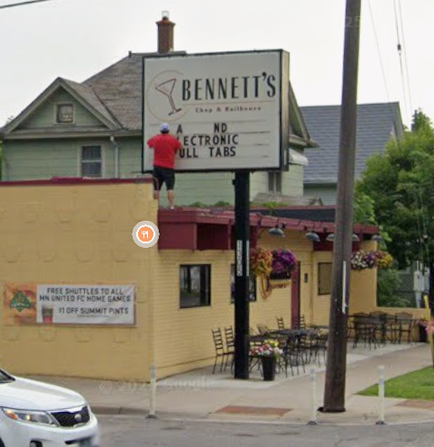
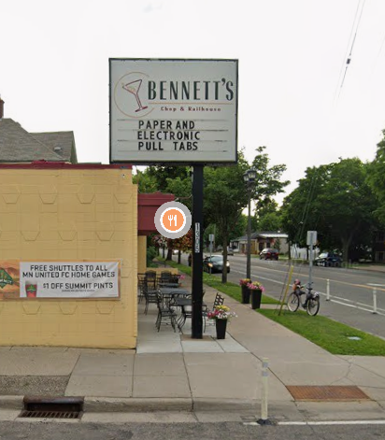
Existing freestanding sign – 1305 7th Street West

Slide 5
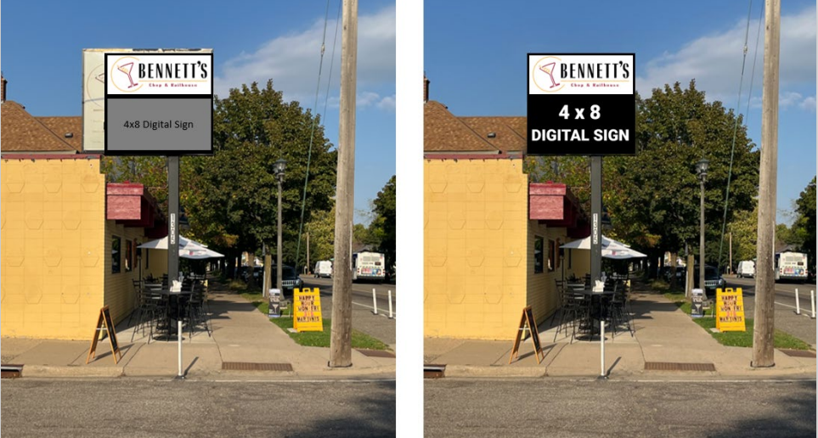
Proposed sign:

Slide 6
Six Findings Necessary to Grant Variance
Staff recommended approval of the variance, finding that all six required findings were met:
The variance is in harmony with the general purposes and intent of the zoning code.
The variance is consistent with the Comprehensive Plan.
The applicant demonstrated practical difficulties in complying with the provision, with the understanding that economic considerations alone do not constitute practical difficulties.
The plight of the landowner is due to circumstances unique to the property and not created by the landowner.
The variance will not permit any use not otherwise allowed in the zoning district.
The variance will not alter the essential character of the surrounding area.
However, the Board of Zoning Appeals denied the variance, determining that Findings 3 and 6 were not met. Specifically, the Board found that practical difficulties were not sufficiently demonstrated and that granting the variance would alter the essential character of the surrounding area.

Slide 7
BZA Outcome (DSIBZA-000232-2025)
Dynamic display sign, 75 feet measured along the road from residential districts and 50 ft from residential districts measured radially; 50 and 47 feet
  variances of 25 and 3 feet
Public hearing held on February 2, 2026
Motion to deny based on Findings 3 and 6
Vote: 3–1 in favor of denial (failed – requires 4 votes)
Motion to approve: 1–0 (failed – no second)
Pursuant to MN Statute § 15.99, failure of a motion constitutes denial

